Slide 1

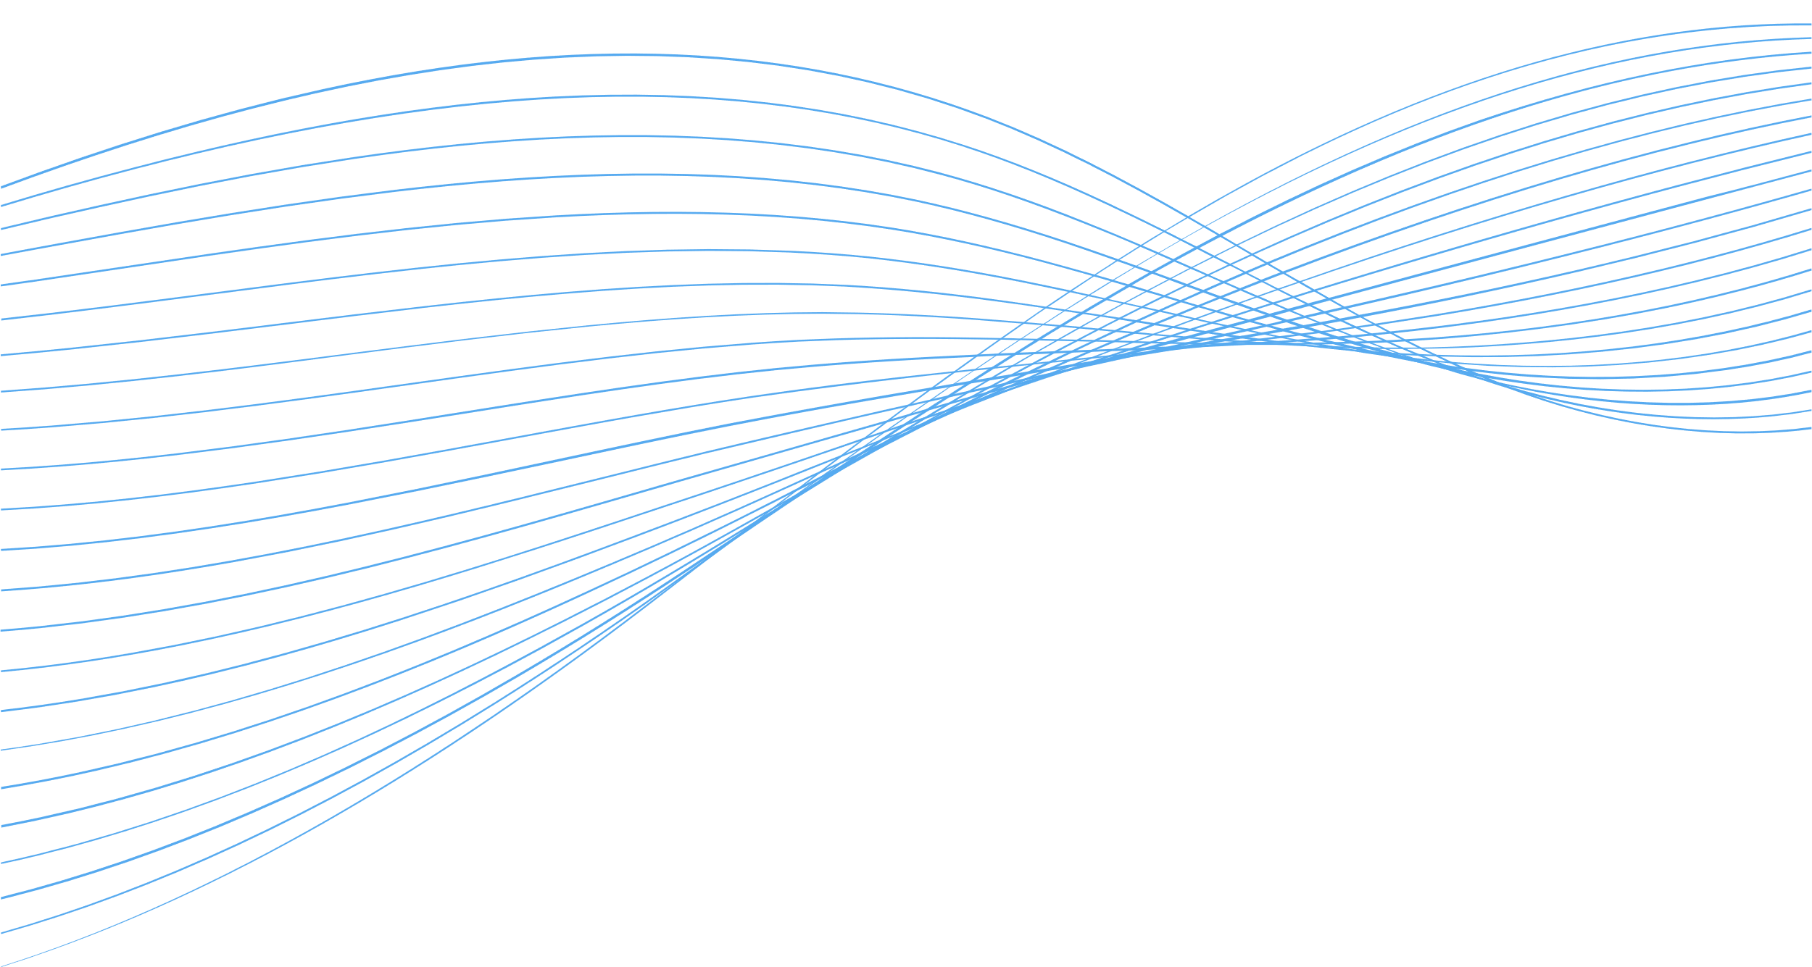

HEALTH COACH APPLICATION SYSTEM
Presented by:
Srija

Slide 2
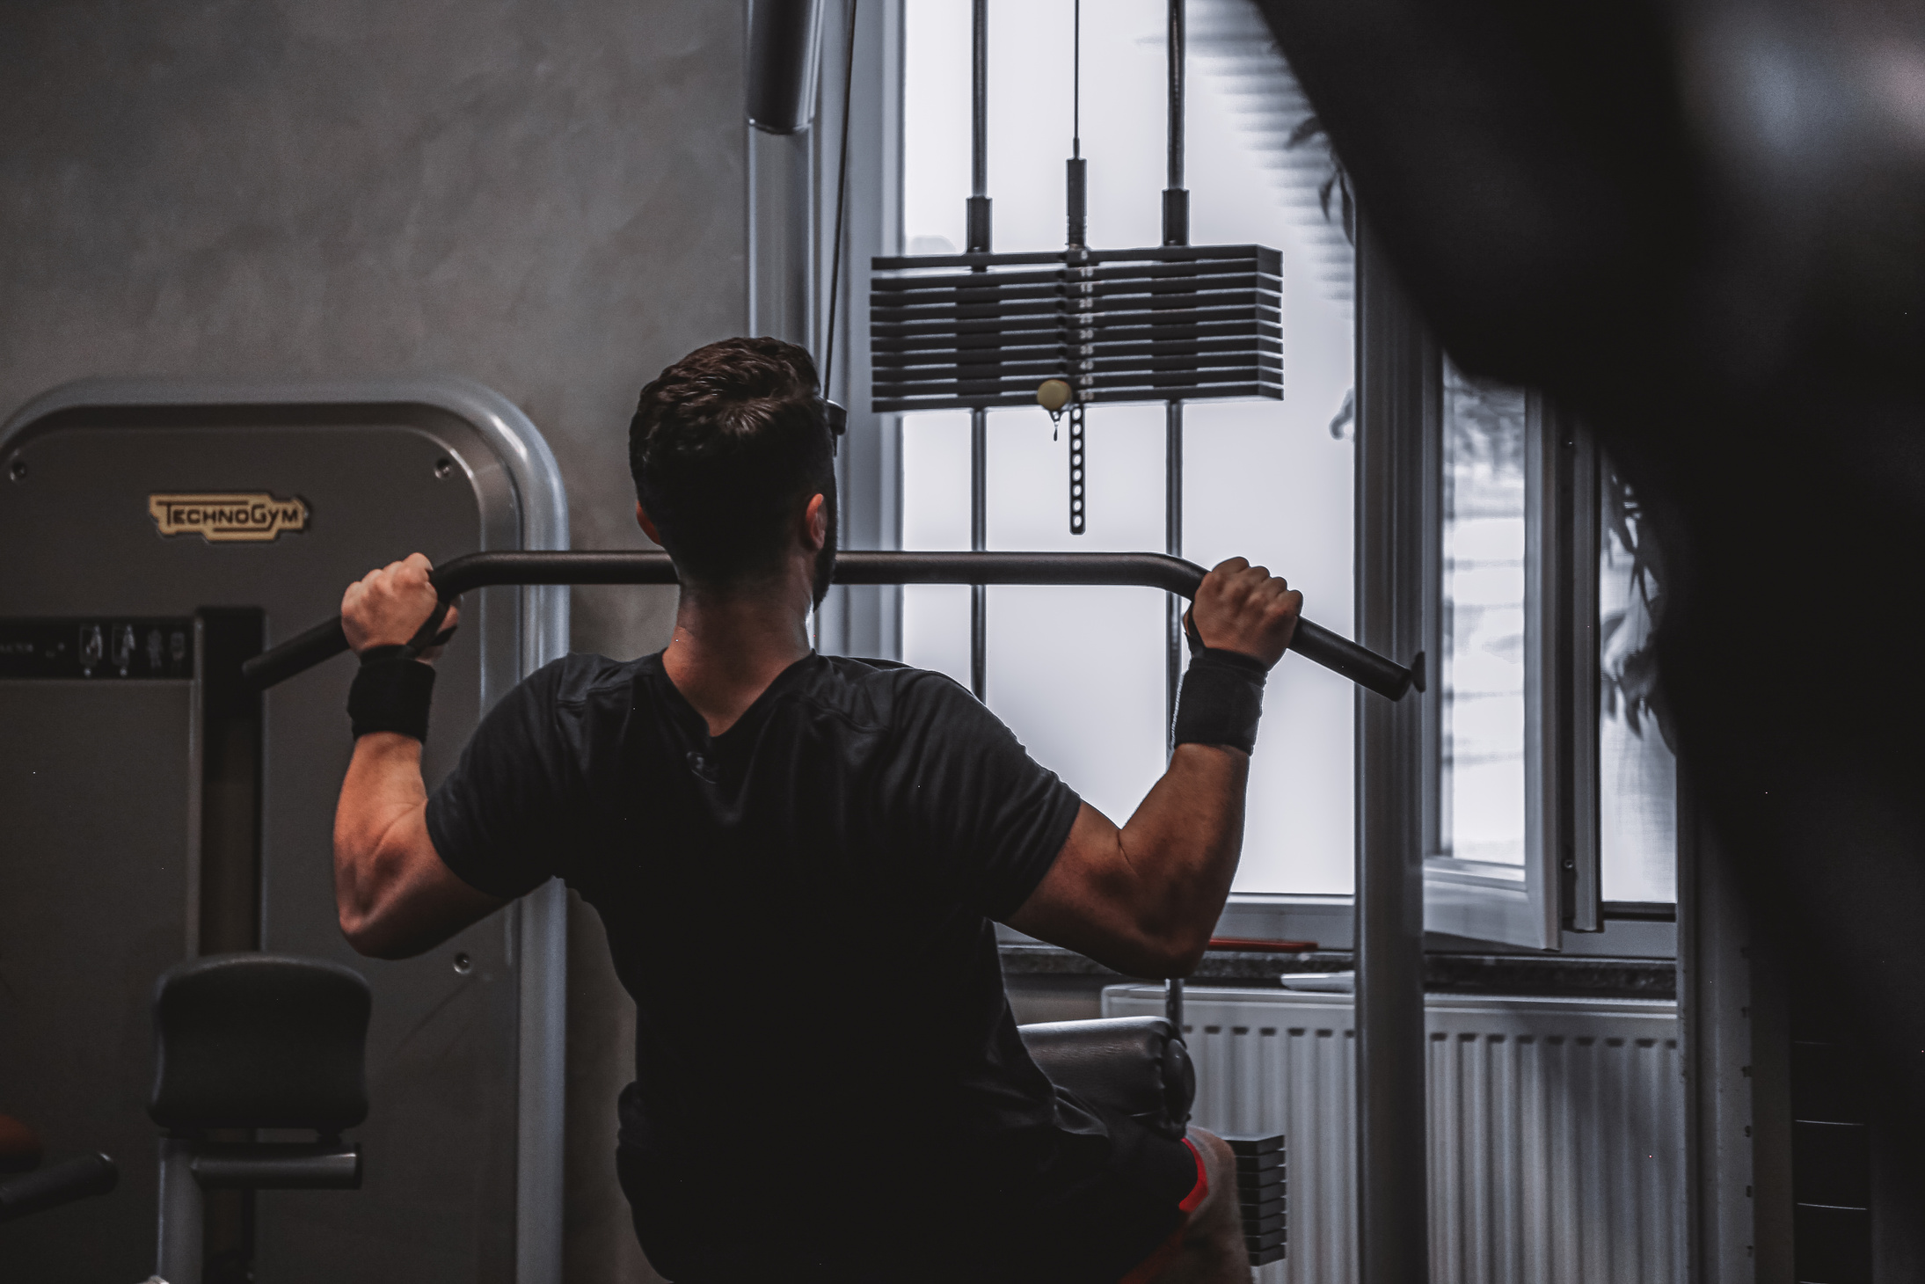
INTRODUCTION
A centralized, web-based platform designed to manage the end-to-end application process for aspiring health coaches.
Supports applicants and a review committee with efficient workflows, transparency, and system integrity.
Comprises a React.js frontend and a Spring Boot backend communicating via secure REST APIs.

Slide 3

PROBLEM STATEMENT
Managing health coach applications requires a system that can handle multiple stages such as submission, review, document management, and status tracking.
The process involves coordination between applicants and reviewers, requiring timely notifications and clear communication.
Ensuring data accuracy, secure storage of personal and professional information, and proper handling of documents are essential.
Without a structured system, it becomes difficult to monitor application status, maintain transparency, and manage user interactions effectively.
A digital solution is needed to centralize and automate the application workflow, improve efficiency, and support end-to-end tracking and decision-making.

Slide 4


OBJECTIVE
Develop a two-tier web application to manage the end-to-end health coach application process.
Provide distinct user interfaces and functionalities for both applicants and reviewers/admins.
Enable real-time notifications and status updates throughout the application lifecycle.
Implement role-based access control and offer detailed reporting capabilities for better decision-making.
MISSION

Slide 5




OUTCOME
Role-Based Accessibility:Separate, tailored interfaces for applicants, reviewers, and admins.
Simplified Workflow: Seamless submission, review, and status tracking for health coach applications.
Enhanced Efficiency: Real-time notifications, secure document handling, and insightful reporting tools.

Slide 6
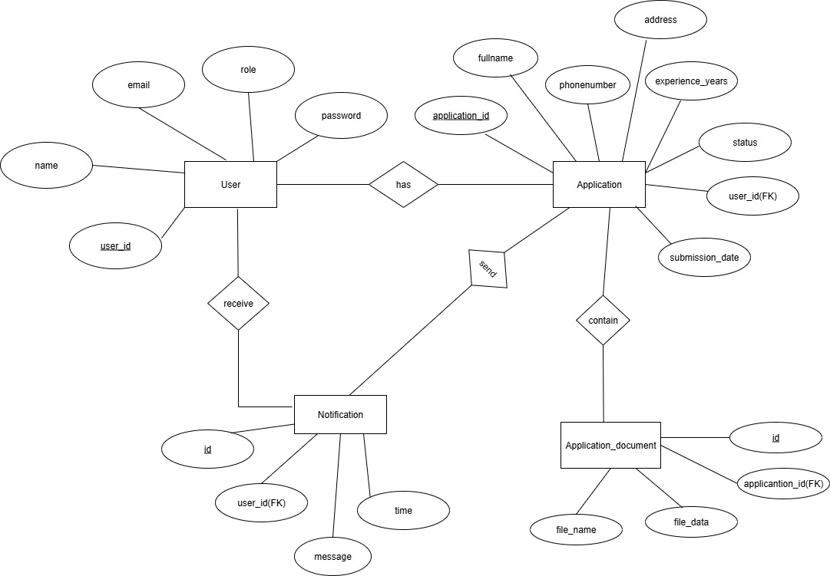
UML DIAGRAMS
ER Diagram

Slide 7
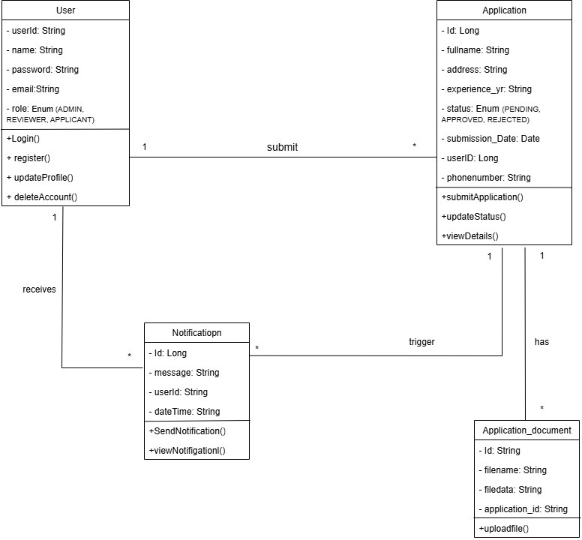
Class Diagram

Slide 8
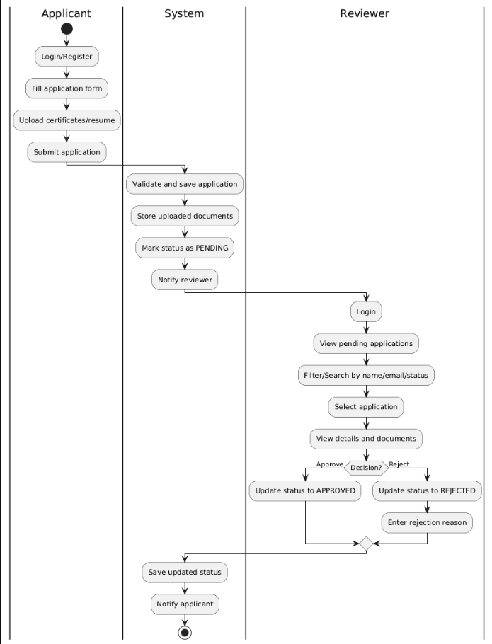
Activity Diagram

Slide 9
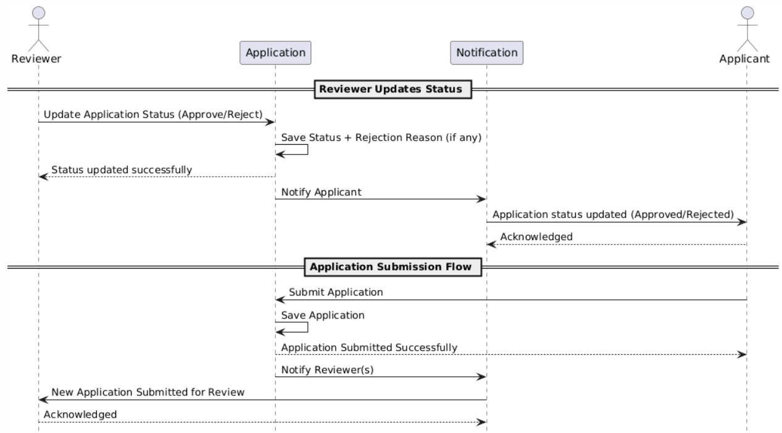
Sequence Diagram

Slide 10

THANK
YOU

